Slide 1


TabPFN-TS: Outperforming Specialized Time Series Models
A breakthrough approach using tabular foundation models for zero-shot time series forecasting.
Shubham Jaysukhbhai Kothiya
Notes:
1

Slide 2
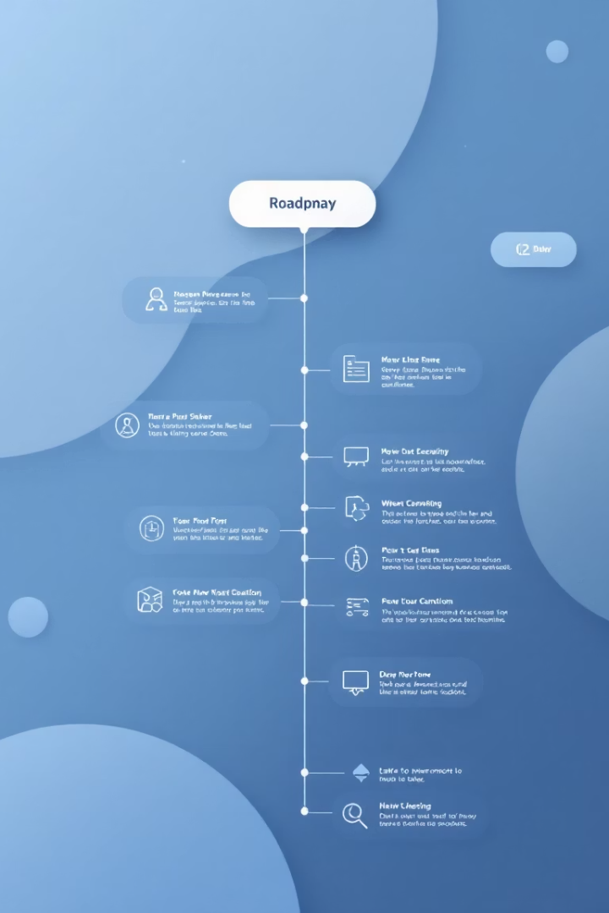










Presentation Overview
Introduction to Forecasting
Model Comparisons
Why We Need Alternatives to Big Models
Key Observations
What is TabPFN & TabPFN-TS?
Strengths & Limitations
Smart Feature Engineering
Why It Matters for the Future
How the Model Works
Performance Results
Notes:
2

Slide 3
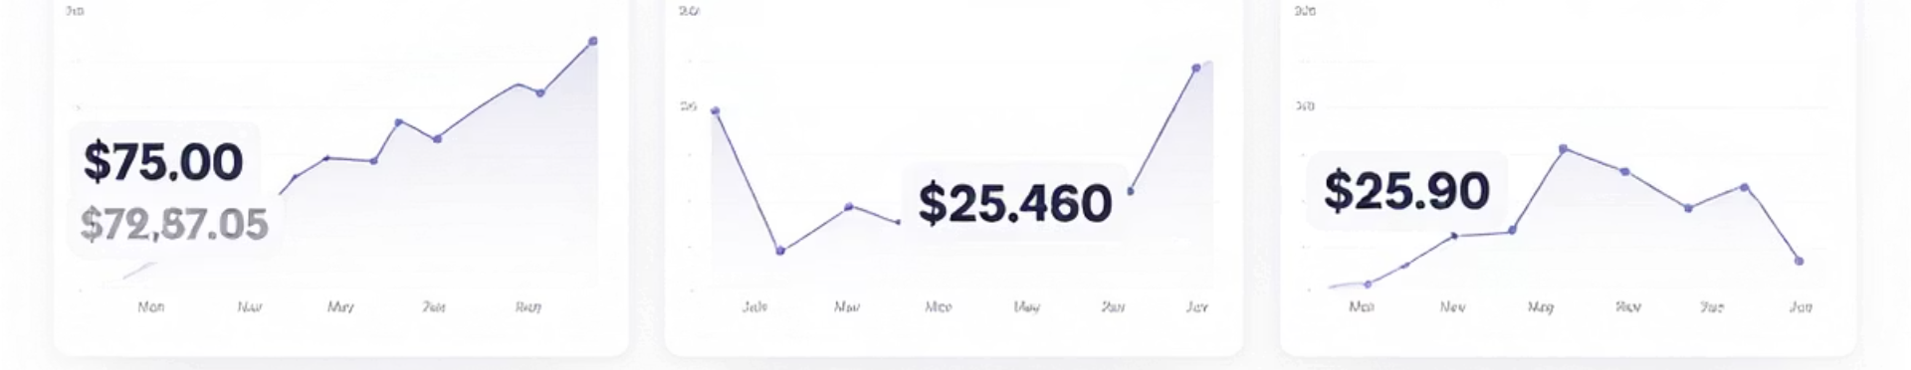
Introduction to Forecasting
Importance of Forecasting
Common Applications
From Traditional to Deep Learning
Time series forecasting plays a crucial role in critical decision-making across various sectors by anticipating future trends and demands.
Its applications span energy management, financial markets, and logistics, helping optimize operations and resource allocation.
While classical models like ARIMA laid the groundwork, deep learning methods now dominate, offering enhanced accuracy and flexibility.
Notes:
3

Slide 4





Challenges with Large Forecasting Models
Data Requirements
Modern forecasting models demand enormous training datasets to achieve strong performance.
Computational Burden
Training and inference costs limit accessibility for many real-world applications.
Benchmark Contamination
Models pretrained on public datasets risk overfitting to benchmark tests.
The Tabular Alternative
Because of these issues, researchers wondered: could a smaller model sidestep these problems? If a lightweight approach like TabPFN-TS works, it would mean fast forecasts without needing mountains of data or risking any sneaky data overlap.
Notes:
4

Slide 5





TabPFN: The Tabular Foundation Model
Tabular Specialist
Synthetic Training
Lightweight Design
Foundation model designed specifically for structured tabular data processing, optimized for fast and plug-and-play predictions on unseen tables.
Trained exclusively on millions of generated datasets with varied statistical properties, learning general patterns from synthetic examples without real data.
Just 11M parameters, ultra lightweight compared to billions in other foundation models, enabling efficient computation and fast inference.
Zero-Shot Capable
Performs well on unseen problems without domain-specific fine-tuning, enabling immediate application to new tabular tasks.
Notes:
5

Slide 6








TabPFN-TS: What is it?
Time Series Forecasting Extension
Extension of TabPFN specialized for time series data
Calendar-aware Features
Converts timestamps into day, month, hour, etc.
Sine/Cosine Encoding
Captures cyclical patterns like weekdays and hours
Multi-step Prediction
Predicts multiple future values without sequence modeling
TabPFN-TS achieves fast and accurate forecasts with an efficient architecture that never saw real time series data during training.
Notes:
6

Slide 7








Feature Engineering Magic
Temporal Extraction
Cyclical Encoding
Day of week (1-7)
Sin/cos transformations
Month (1-12)
Preserves periodicity
Hour (0-23)
Maintains distance relationships
Position index
Sequence-Free Approach
Pattern Recognition
No RNNs or attention
Weekly trends
Pure tabular representation
Seasonal effects
Computationally efficient
Diurnal variations
Notes:
7

Slide 8
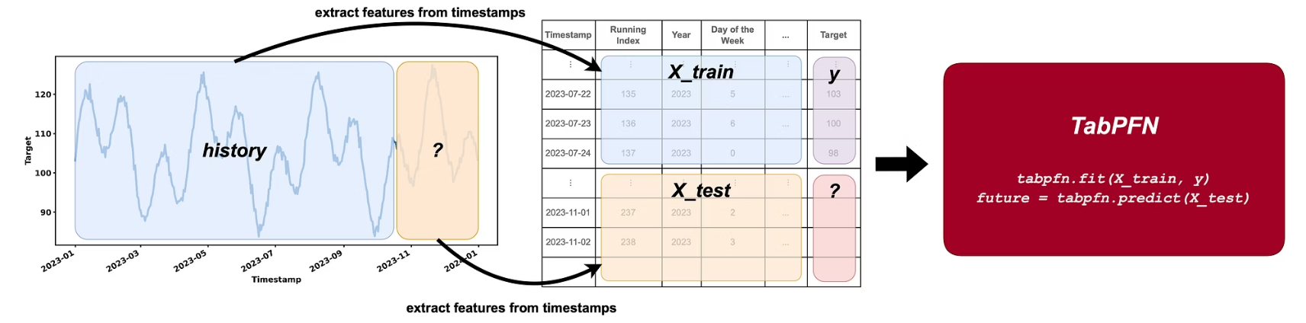
How TabPFN-TS Model Works
Feature Extraction
Transform timestamps into engineered features that capture temporal patterns.
TabPFN Processing
Feed processed tabular data through the foundation model without specialized training.
Forecast Generation
Produce accurate predictions for future time points directly from tabular outputs.
Notes:
8

Slide 9
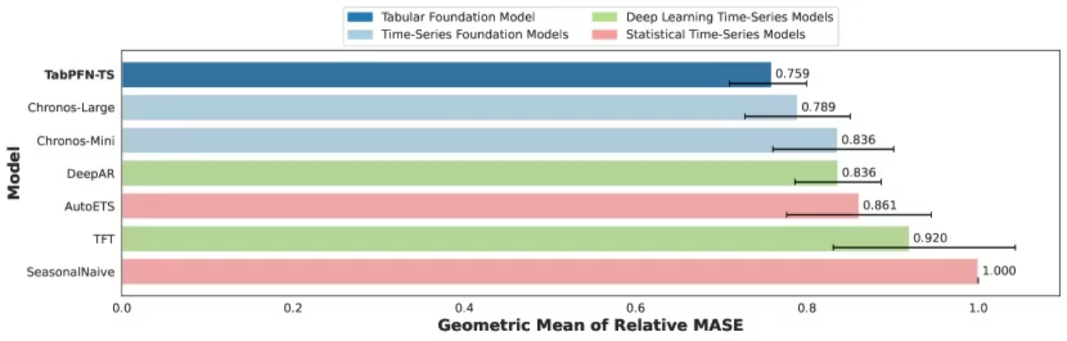
Performance Results
TabPFN-TS achieves an average MASE of 0.759 across 24 diverse datasets, demonstrating superior forecasting accuracy.
It outperforms the following models:
Chronos-Large (MASE ≈ 0.789), a massive 710M parameter model
Chronos-Mini (MASE ≈ 0.836)
DeepAR and TFT, both deep learning methods
AutoETS, a classic statistical forecasting method
All this is achieved with a lightweight model of just 11M parameters 🤯, making TabPFN-TS fast and efficient.
Notes:
9

Slide 10
Model Comparison
Model
Parameters
MASE (Accuracy)
Training Data
TabPFN-TS
11M
0.759 (Best)
Zero real time series data
Chronos-Large
710M
0.789
Real data used
Chronos-Mini
Unknown
0.836
Real data used
DeepAR
Unknown
Higher than TabPFN-TS
Real data used
TFT
Unknown
Higher than TabPFN-TS
Real data used
AutoETS
Classic Statistical
Higher than TabPFN-TS
Real data used
Key Highlights:
TabPFN-TS is the smallest model
TabPFN-TS achieves the highest accuracy
TabPFN-TS was trained with zero real time series data
Notes:
10

Slide 11
Strengths & Limitations
Strengths
Limitations
TabPFN-TS is the smallest model
Fast, small, generalizes well
Small but mighty : Just 11M parameters, yet it outperforms models 60–70× its size.
Makes it fast, lightweight, and deployable even on limited hardware.
No fine-tuning required: Works out-of-the-box with zero gradient descent.
Perfect for quick deployment and use in production.
No lag inputs
Local-only
Doesn’t use external covariates
Not optimized for huge datasets
Currently doesn’t support additional features like promotions, weather, or prices. Might limit its performance in multi-factor real-world use cases.
Notes:
11

Slide 12



Key Takeaways & Future Directions
Benchmark-Beating Results
TabPFN-TS outperforms specialized models with fraction of resources
Feature Engineering Insights
Smart transformations eliminate need for complex architectures
Research Implications
Foundation models may replace specialized architectures across domains
This research demonstrates how foundation models with clever feature engineering can revolutionize forecasting applications while reducing computational demands.
Notes:
12

Slide 13
References
Lim, B., Arık, S. Ö., Loeff, N., & Pfister, T. (2021). Temporal Fusion Transformers for Interpretable Multi-Horizon Time Series Forecasting. IJF
Official TabPFN GitHub: https://github.com/automl/tabpfn-client
TabPFN-TS Time Series Implementation: https://github.com/liam-sbhoo/tabpfn-
Papers With Code — Time Series Forecasting: https://paperswithcode.com/task/time-series-forecasting
Awesome Time Series Foundation Models: https://github.com/zhengzangw/awesome-huge-models
Hoo, S. B., Müller, S., Salinas, D., & Hutter, F. (2025). The Tabular Foundation Model TabPFN Outperforms Specialized Time Series Forecasting Models Based on Simple Features. arXiv:2501.02945
Notes:
13

Slide 14

Thank You
Thank you for your attention and interest.
I appreciate your time and look forward to any
questions you may have.
Notes:
14

